Slide 1
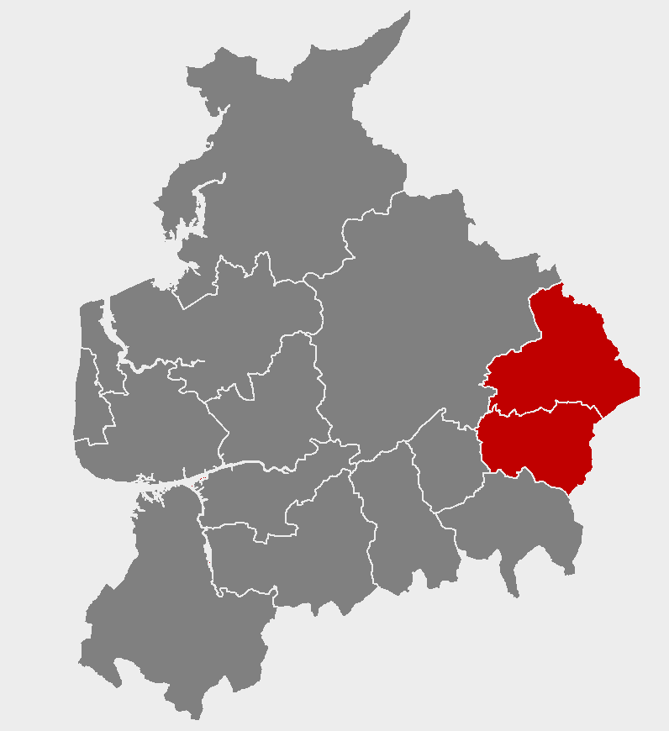
Work and job opportunities in your area
Notes:
*****PLEASE READ*****
1) This slideshow is for PRESENTATION USE only. Please do not use these slides for print out/ hard copy as some of the slides will not make sense.
2) Do not edit the content or animations on each of the slides, as this will affect the timings of the presentation. If you need to make the presentation shorter, removing whole slides will allow for the presentation to remain aligned with the animations and transitions.
3) The music will only play if the presentation is started from the first slide. Please avoid stopping and resuming the presentation, as this will result in a silent slideshow.
4) For any queries, please contact LancsSkillsHub@lancashirelep.co.uk

Slide 2
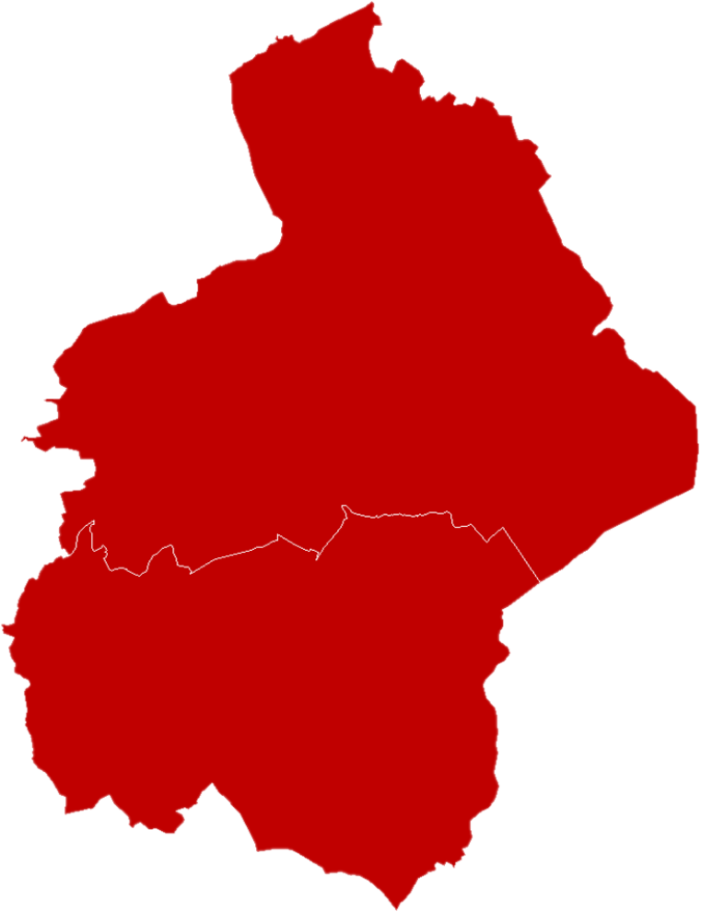

Slide 3
Barnoldswick
What do you know about the jobs in your local area?
Colne
Barrowford
Nelson
Burnley

Slide 4
West Craven Business Park
There are 75,000 jobs across the area
Ribble Valley 2,300
Around 1 in 3 people work outside the area
Barnoldswick
Hyndburn 3,380
Colne
Whitewalls Industrial Estate
Barrowford
Nelson
Blackburn with Darwen
3,350
Lomeshaye Industrial Estate
Burnley
The darker the colour, the more people are employed
Orient and Network 65 Business Parks
West Burnley
Rossendale
1,220

Slide 5
An overview of your area
5,780
8,000
Are self-employed
Number of businesses
5,000
Are unemployed
76,300
People in work
Just over one-quarter of people have gone onto higher education

Slide 6
The top five industries with the most jobs are:
£
14,000 JOBS
Advanced Manufacturing
11,000 JOBS
Retail (including motor trade)
10,000 JOBS
Health and Social Care
9,000 JOBS
Financial and Professional Sector
7,000 JOBS
Education

Slide 7
What are some of the businesses in these sectors?
£
14,000 JOBS
Advanced Manufacturing
11,000 JOBS
Retail (including motor trade)
10,000 JOBS
Health and Social Care
9,000 JOBS
Financial and Professional Sector
7,000 JOBS
Education

Slide 8
There are some well known large businesses, but most employ fewer than 10 people
25
Are large businesses
(Employing 250+ people)
110
Are medium-sized businesses
(Employing 50 to 249 people)
560
Are small businesses
(Employing 10-49 people)
5,080
Are micro businesses
(Employing 0-9 people)

Slide 9
Where are key employers based in your area?
Pendleside Hospice
Rolls Royce
Leggett and Platt Springs
Silent Night
In-Situ
Barnoldswick
Liberata
Pendle Borough Council
+ 24 Marketing
Colne
Nelson and Colne College
Barrowford
The Landmark
Nelson
TRW Automotive
BCN Group
Burnley Teaching Hospital
Fort Vale Engineering
Sarfan Nacelles
Burnley
Exertis
Burnley College
Door 4
Paradigm Precision Engineering
Warburtons
BPM SFX

Slide 10
Local employers will need to recruit over 7,900 workers each year over the next decade to meet sector growth and replace those leaving their jobs
£
1,500 JOBS
Wholesale and Retail
1,200 JOBS
Financial and Professional Sector
1,000 JOBS
Manufacturing
900 JOBS
Health and Social Care
800 JOBS
Creative and Digital
700 JOBS
Visitor Economy
700 JOBS
Education
500 JOBS
Construction

Slide 11
The skills that are highly desired by local employers are:
Time management
Teamwork
Communication
Digital skills
Initiative
Critical thinking and problem solving

Slide 12
Over the next 10 years businesses will be looking for employees with higher qualifications
920 JOBS
Level 4 Degree HND / HNC / NVQ 4
890 JOBS
Level 3 A & AS Level / NVQ 3
-1,670 JOBS
Level 2 GCSE 9-4 /NVQ 1
-1,140 JOBS
Level 1 GCSE 3-1 NVQ 1
-1,640 JOBS
No qualifications
In addition, 2,120 jobs per year are expected to require other qualifications, including apprenticeships, for which the level is not specified

Slide 13
The higher the qualifications you have, the more you can earn
£757 per week
£531 per week
£513 per week
£511 per week
£413 per week
No qualifications
Level 1 GCSE 3-1 NVQ 1
Level 2 GCSE 9-4 /NVQ 1
Level 3 A & AS Level / NVQ 3
Level 4 Degree HND / HNC / NVQ 4
Figures reflect average earnings by highest qualifications held, at the national level.
Notes:
Source: Careers Online - Weekly Earnings by Qualification, 2019
These figures are national (rather than local) evidence, reflecting limits on data availability

Slide 14
Living in your area is cheaper than other areas of England
£240,000
£105,000
£150,000
£90,000
Burnley
Pendle
Lancashire
England
With cheaper house prices across your area, you will be able to save for a house quicker than other areas of England

Slide 15
14,490 residents of your area are participating in Further Education (FE)
Data for local FE providers shows…
0.9%
Attend Schools
0.5%
Attend Private Sector Funded Institutions
98.7%
Attend General FE College
FE students tend to be older in your area compared to the rest of England.
Figures may not sum due to rounding.
Notes:
Due to data limitations, the analysis of the student age profile relates to FE provision that is ESFA-funded and captured in Individualised Learner Record returns only. This excludes school sixth form provision which accounts for 196 learners

Slide 16
There are lots of options for young people finishing education at age 18
62%
Carry on in education
Of which…
53%
7%
2%
Go to university
Into other types of education
Go to college
82%
In sustained education or employment
20%
Go into employment
8%
Of which do an apprenticeship

Slide 17
1,570
People in your area started an apprenticeship in 2018/19
470 Were under the age of 19 and 1,090 were over the age of 19
The most popular subject areas are:
£
420
Business, Administration and Law
410
Health, Public Services and Care
290
Engineering and Manufacturing
180
Retail and Commercial Enterprise
100
Construction, Planning and the Built Environment
70
Information and Communication Technology
Figures do not sum due to rounding.

Slide 18
Advanced and higher levels account for 54% of under 19 apprenticeships
and
70% of over 19 apprenticeships in your area

Slide 19
For more information
Click this link to go to the corresponding TTWA LMI Report

