Slide 1
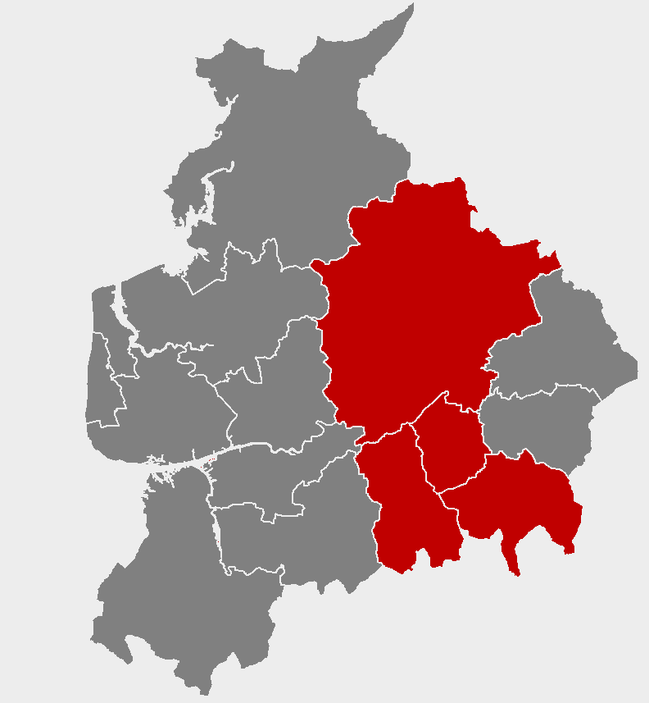
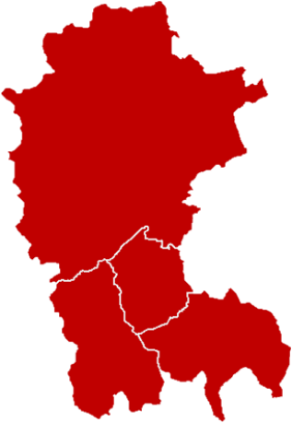

Work and job opportunities in your area
Notes:
*****PLEASE READ*****
1) This slideshow is for PRESENTATION USE only. Please do not use these slides for print out/ hard copy as some of the slides will not make sense.
2) Do not edit the content or animations on each of the slides, as this will affect the timings of the presentation. If you need to make the presentation shorter, removing whole slides will allow for the presentation to remain aligned with the animations and transitions.
3) The music will only play if the presentation is started from the first slide. Please avoid stopping and resuming the presentation, as this will result in a silent slideshow.
4) For any queries, please contact LancsSkillsHub@lancashirelep.co.uk

Slide 3


What do you know about the jobs in your local area?
Clitheroe
Longridge
Accrington
Blackburn
Rossendale
Darwen

Slide 4
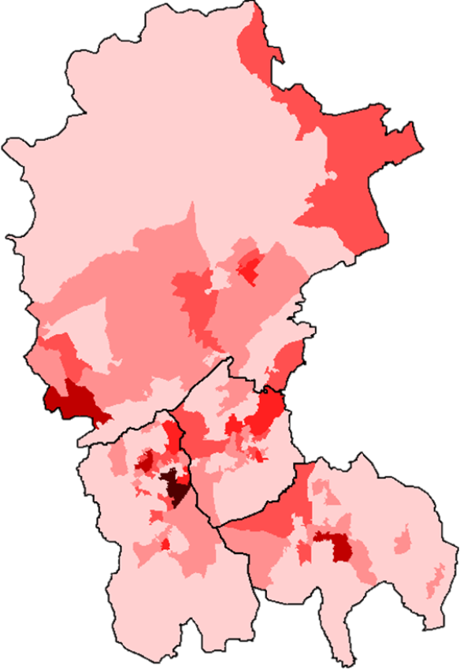
There are 153,600 jobs across the area
Around 1 in 3 people work outside the area
Preston (5,450)
Clitheroe
Longridge
Moorfield Industrial Estate
Samlesbury
Burnley (6,240)
Accrington
Blackburn
Shadsworth and Walker Industrial Estates
The darker the colour, the more people are employed
Rossendale
Darwen
Manchester (3,020)
Bury (3,160)
Rochdale (3,110)

Slide 5
An overview of your area
13,320
20,300
Are self-employed
Number of businesses
7,200
Are unemployed
155,700
People in work
Almost one-third of people have gone onto higher education

Slide 6
The top five industries with the most jobs are:
£
23,000 JOBS
Advanced Manufacturing
21,000 JOBS
Health and Social Care
20,000 JOBS
Retail (including motor trade)
£
18,000 JOBS
Financial and Professional Sector
17,000 JOBS
Logistics

Slide 7













What are some of the businesses in these sectors?
£
23,000 JOBS
Advanced Manufacturing
21,000 JOBS
Health and Social Care
20,000 JOBS
Retail (including motor trade)
£
18,000 JOBS
Financial and Professional Sector
17,000 JOBS
Logistics

Slide 8
There are some well known large businesses, but most employ fewer than 10 people
40
Are large businesses
(Employing 250+ people)
240
Are medium-sized businesses
(Employing 50 to 249 people)
1,300
Are small businesses
(Employing 10-49 people)
11,745
Are micro businesses
(Employing 0-9 people)

Slide 9
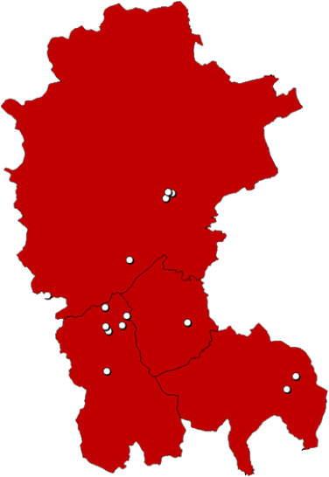
Where are key employers based in your area?
Ribble Valley Council
Northcote Group
Printed Cup Company
GTA England
James Places
Education Partnership Trust
Digital 22
Clitheroe
Exertis
BAE Systems
Longridge
Allermuir
Forbes Solicitors
Harworths Chartered Accountants
Accrington
Blackburn Youth Zone
Blackburn
Herbert Parkinson
Orthoplastics
Darwen
Rossendale
Rossendale Borough Council
KAMAN Composites
PM & M Accounting
Big Bear Confectionary
Bensons for Beds

Slide 10
Local employers will need to recruit over 19,000 workers each year over the next decade to meet sector growth and replace those leaving their jobs
£
4,100 JOBS
Wholesale and Retail
2,600 JOBS
Health and Social Care
2,600 JOBS
Financial and Professional Sector
2,200 JOBS
Manufacturing
1,900 JOBS
Visitor Economy
1,500 JOBS
Creative and Digital
1,400 JOBS
Education
700 JOBS
Construction

Slide 11
The skills that are highly desired by local employers are:
Time management
Teamwork
Communication
Digital skills
Initiative
Critical thinking and problem solving

Slide 12
Over the next 10 years businesses will be looking for employees with higher qualifications
900 JOBS
Level 4 Degree HND / HNC / NVQ 4
900 JOBS
Level 3 A & AS Level / NVQ 3
-1,700 JOBS
Level 2 GCSE 9-4 /NVQ 1
-1,100 JOBS
Level 1 GCSE 3-1 NVQ 1
-1,600 JOBS
No qualifications
In addition, 2,100 jobs per year are expected to require other qualifications, including apprenticeships, for which the level is not specified

Slide 13
The higher the qualifications you have, the more you can earn
£757 per week
£531 per week
£513 per week
£511 per week
£413 per week
No qualifications
Level 1 GCSE 3-1 NVQ 1
Level 2 GCSE 9-4 /NVQ 1
Level 3 A & AS Level / NVQ 3
Level 4 Degree HND / HNC / NVQ 4
Figures reflect average earnings by highest qualifications held, at the national level.
Notes:
Source: Careers Online - Weekly Earnings by Qualification, 2019
These figures are national (rather than local) evidence, reflecting limits on data availability

Slide 14
Living in your area is cheaper than other areas of England
£217,250
£240,000
£119,950
£130,000
£150,000
£100,000
Hyndburn
Blackburn with Darwen
Rossendale
Lancashire
Ribble Valley
England
With cheaper house prices across your area, you will be able to save for a house quicker than other areas of England

Slide 15
24,830 residents of your area are participating in Further Education (FE)
Data for local FE providers shows…
4%
Attend Sixth Form College
14%
Attend Other Public Funded Institutions
(Local Authorities and Higher Education)
46%
Attend General FE College
14%
Attend Schools
22%
Attend Private Sector Funded Institutions
FE students tend to be younger in your area compared to the rest of England.
Figures may not sum due to rounding.
Notes:
Due to data limitations, the analysis of the student age profile relates to FE provision that is ESFA-funded and captured in Individualised Learner Record returns only. This excludes school sixth form provision which accounts for 2,800 learners

Slide 16
There are lots of options for young people finishing education at age 18
65%
Carry on in education
Of which…
56%
6%
3%
Go to university
Into other types of education
Go to college
81%
In sustained education or employment
16%
Go into employment
9%
Of which do an apprenticeship

Slide 17
3,350
People in your area started an apprenticeship in 2018/19
1,200 Were under the age of 19 and 2,150 were over the age of 19
The most popular subject areas are:
£
920
Business, Administration and Law
810
Health, Public Services and Care
580
Engineering and Manufacturing
390
Retail and Commercial Enterprise
210
Construction, Planning and the Built Environment
160
Information and Communication Technology
Figures may not sum due to rounding.

Slide 18
Advanced and higher levels account for 43% of under 19 apprenticeships
and
69% of over 19 apprenticeships in your area
Figures may not sum due to rounding.

Slide 19
For more information
Click this link to go to the corresponding TTWA LMI Report

